Slide 1
Unit 2 Scan Conversion Algorithm LH 2

Slide 2
Bresenham Line Algorithm
Bresenham’s Line Algorithm (BLA)
The BLA is a more efficient method used to plot pixel position along a straight-line path.
Advantage of BLA over DDA
• In DDA algorithm each successive point is computed in floating point, so it requires more time and more memory space.
While in BLA each successive point is calculated in integer value or whole number. So it requires less time and less memory space.
• In DDA, since the calculated point value is floating point number, it should be rounded at the end of calculation but in BLA it does not need to round, so there is no accumulation of rounding error.
• Due to rounding error, the line drawn by DDA algorithm is not accurate, while in BLA line is accurate.
• DDA algorithm cannot be used in other application except line drawing, but BLA can be implemented in other application such as circle, ellipse and other curves.

Slide 3
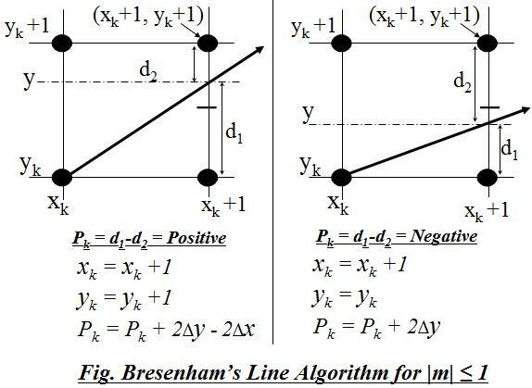
BLA for slope +ve and |m| ≤ 1

Slide 4
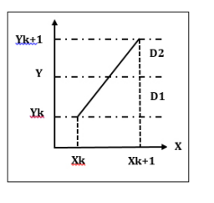
Here, we see that the line passes through,
Y = m (Xk+1) + b Or,
D1 = Y – Yk = m (Xk+1) + b –Yk
Similarly, D2 = (Yk+1) – Y = (Yk+1) – m (Xk+1) – b The decision parameter is obtained by defining: Pk = ∆x (D1-D2)
= ∆x {m * (Xk+1) + b – Yk - (Yk + 1) + m * (Xk+1) + b}
Or, Pk = ∆x {2m * (Xk+1) + 2b – Yk – (Yk+1)}
∴ Pk = 2∆x * m(Xk+1) + 2∆x * b - ∆x * Yk - ∆x * (Yk+1)

Slide 5
Here,
(Xk + 1) = Xk + 1
(Yk + 1) = Yk + 1
So, Pk = 2∆x * m(Xk+1) + 2∆x * b - ∆x * Yk - ∆x * (Yk+1)
But m = ∆ y ∆ x
Pk = 2∆x * ∆ y ∆ x (Xk+1) + 2∆x * b - ∆x * Yk - ∆x * (Yk+1)
= 2∆yXk + 2∆y + 2b∆x - ∆xYk - ∆xYk - ∆x
= 2∆yXk-2∆xYk+2∆y+2b∆x-∆x
= 2∆yXk-2∆xYk+c -------------------------- (i)

Slide 6
The difference between these two separation is,
D1 - D2 = [m (xk +1) + c - Yk ] - [Yk+1– {m (xk +1) + c }]
Or,
D1- D2 = 2m (xk+1)+ 2c - 2yk -1
Since, slope of line (m) = Δy / Δx,
We have,
Δx (D1- D2) = 2 Δy (xk+1)+ 2 Δx C - 2 Δx Yk – Δx
Define Decision parameter at Kth step,
Pk = Δx (D1- D2)
= 2 Δy (xk+1)+ 2 Δx C - 2 Δx yk – Δx
=2 Δy Xk + 2 Δy + 2 Δx C - 2 Δx yk – Δx

Slide 7
Where c = 2∆y+2b∆x-∆x
At step (k+1), the decision parameter is calculated as: Pk+1 = 2∆y * (Xk+1)-2∆x * (Yk +1) + c
Now, Pk+1 – Pk = 2∆y {(Xk + 1) - Xk} - 2∆x {(Yk + 1) - Yk}
Or, Pk + 1
= Pk + 2∆y {(Xk + 1) - Xk} - 2∆x {(Yk + 1) - Yk}
But, (Xk + 1) = Xk + 1 and (Yk+1 = Yk + 1
Now, Pk + 1 = Pk + 2∆y {Xk + 1 - Xk} - 2∆x {(Yk + 1) - Yk}
= Pk + 2∆y - 2∆x {Yk + 1 - Yk}
= Pk + 2∆y - 2∆x

Slide 8
We first calculate P0 = 2∆y - ∆x
If Pk < 0 i.e. D1 < D2 then next point we plot is (Xk+1, Yk) and
Pk + 1 = Pk +2∆y
Else, next point we plot is (Xk + 1, Yk + 1) and calculate
Pk + 1 = Pk + 2∆y - 2∆x
.

Slide 9
Bresenham Algorithm:
Input two end points store that left end point in (X0, Y0)
Calculate the constant ∆x, ∆y, 2∆y and 2∆y - 2∆x and obtain the starting value as P0 = 2∆y - ∆x where, ∆x =|x2 – x1| and ∆y = |y2 – y1|
At each Xk along the line starting at k = 0 perform. If Pk < 0 the next point to plot is (Xk + 1, Yk) and calculate Pk + 1 = Pk + 2∆y otherwise, next point to plot is (Xk+1, Yk+1) and Pk+1 = Pk+2∆y-2∆x.
Repeat step 3 until we get final result

Slide 10
Initial Decision Parameter (P0)
y = m(Xk+1) + C
Let, X0 = 0 , Y0 = 0 then C = 0
Δx (d1- d2) = 2 Δy Xk + 2 Δy + 2 Δx c - 2 Δxyk – Δx
P0 = 0 + 2Δy + 0 + 0 –Δx
P0 = 2 Δy - Δx

Slide 11
Example-1: Digitize the line with end points (20, 10) and (30, 18) using BLA.
Solution :
Here, Starting point of line = (x1, y1) = (20, 10) and
Ending point of line = (x2, y2) = (30, 18)
Thus, slope of line, m = Δy / Δx = y2-y1 / x2-x1
= (18-10) / (30-20)
= 8/10
It is clear that the line is moving left to right with the positive slope
|m| = 0.8 <1

Slide 12
The initial decision parameter (P0) = 2Δy - Δx = 2*8 – 10 = 6
Since, for the Bresenham’s Line drawing Algorithm of slope, |m| ≤ 1, we have
If Pk < 0 (i.e. d1-d2 is Negative )
then,
Xk+1 = Xk+1
Yk+1 = Yk
Pk = Pk + 2 Δy
If Pk ≥ 0
then,
Xk+1 = Xk+1
Yk+1 = Yk+1
Pk = Pk + 2 Δy -2Δx

Slide 13
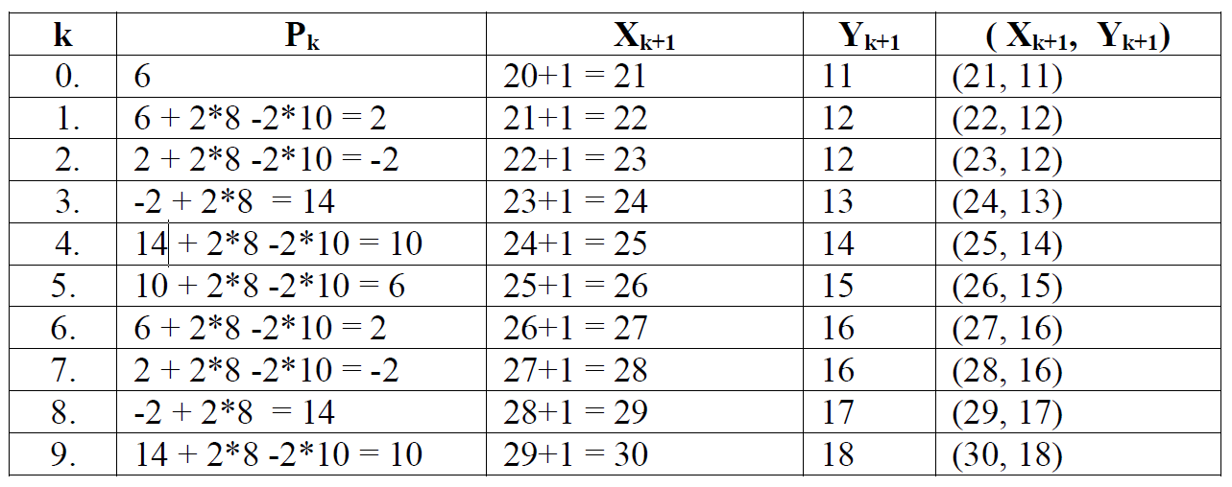

Slide 14
Digitize the line with end points (5, 5) and (13, 9) using BLA.

